Slide 1
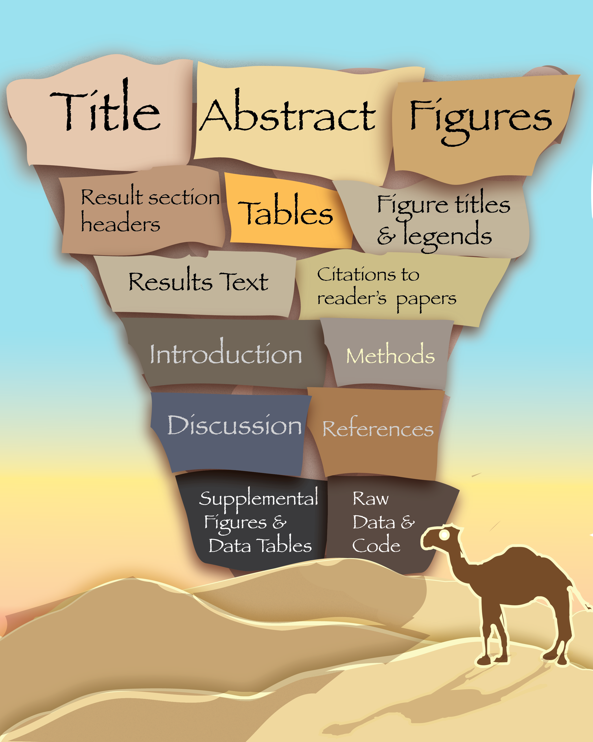

Slide 2
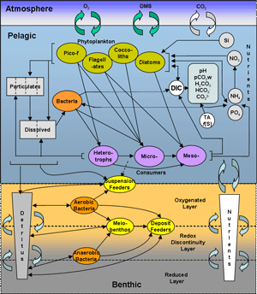
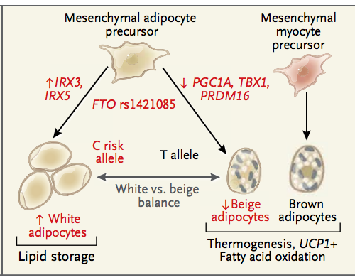
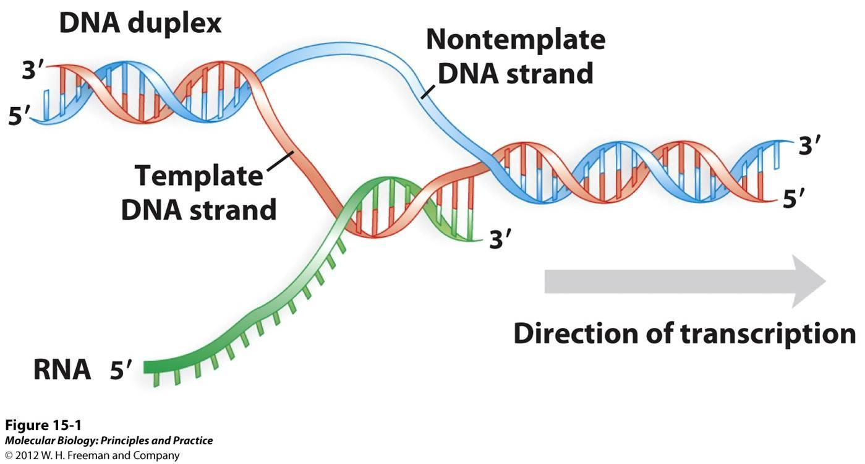
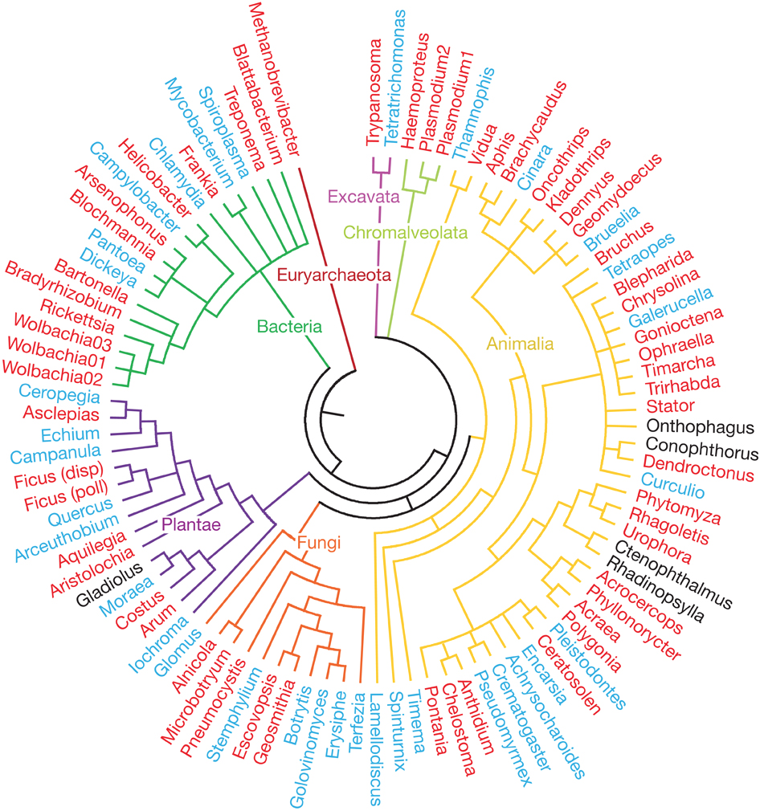
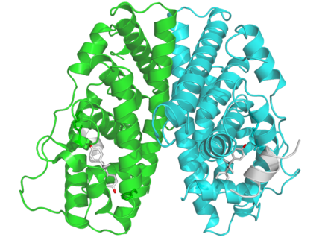
Bioinformatics: Overview
Ecosystems
Organismal
health or disease
Cellular processes & Metabolism
(e.g. ecosystem models)
(e.g. Regulation of transcription
and translation, metabolic networks)
(e.g. development;
Immunity;
modeling neural biology)
Evolution
(e.g. Signatures
Of selection;
Phylogeny;
Gene transfer;
Ressurecting
extinct proteins)
Molecules &
Macromolecular Complexes
Source: Estrogen receptor image: https://en.wikipedia.org/wiki/Estrogen_receptor
Txn image: Molecular Biology: Principles and Practice © 2012 W.H Freeman and Company. Adipocyte browning: http://compbio.mit.edu/publications/139_Claussnitzer_NEJM_15.pdf Ecosystem model: http://www.meece.eu/library/ersem.html Phylogeny: Gomez et al., Nature 2010.
(e.g. DNA sequence analysis,
protein folding, RNA folding)

Slide 3
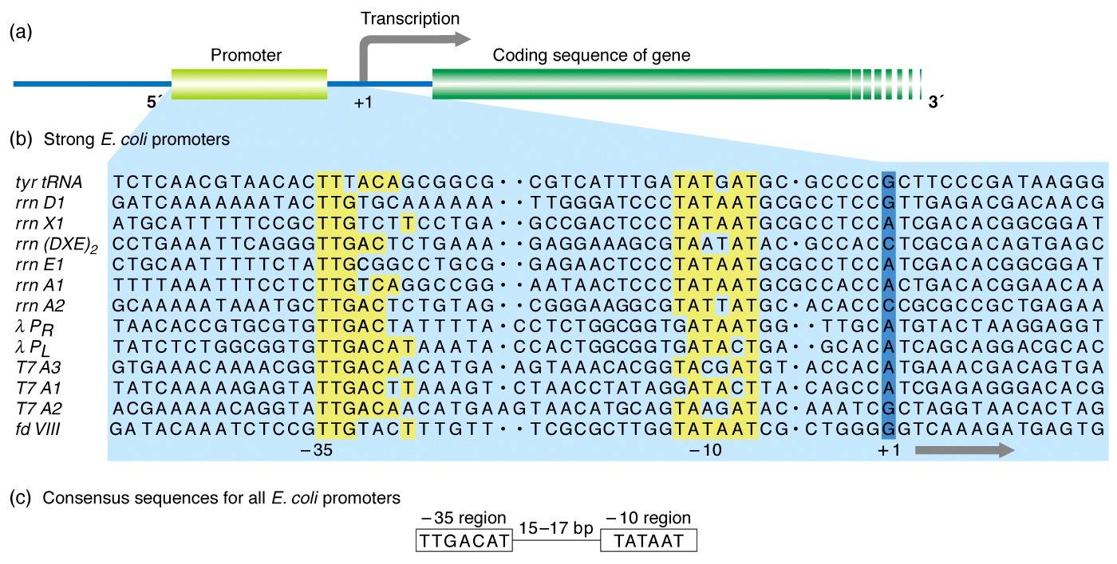
Bioinformatics: Sequences!
Set 2 – an idealized TATA box (here as an E.coli promoter)
Source: https://www.mun.ca/biology/scarr/MGA2-03-11.jpg

Slide 4
Commandline Treasure Hunt!

Slide 5
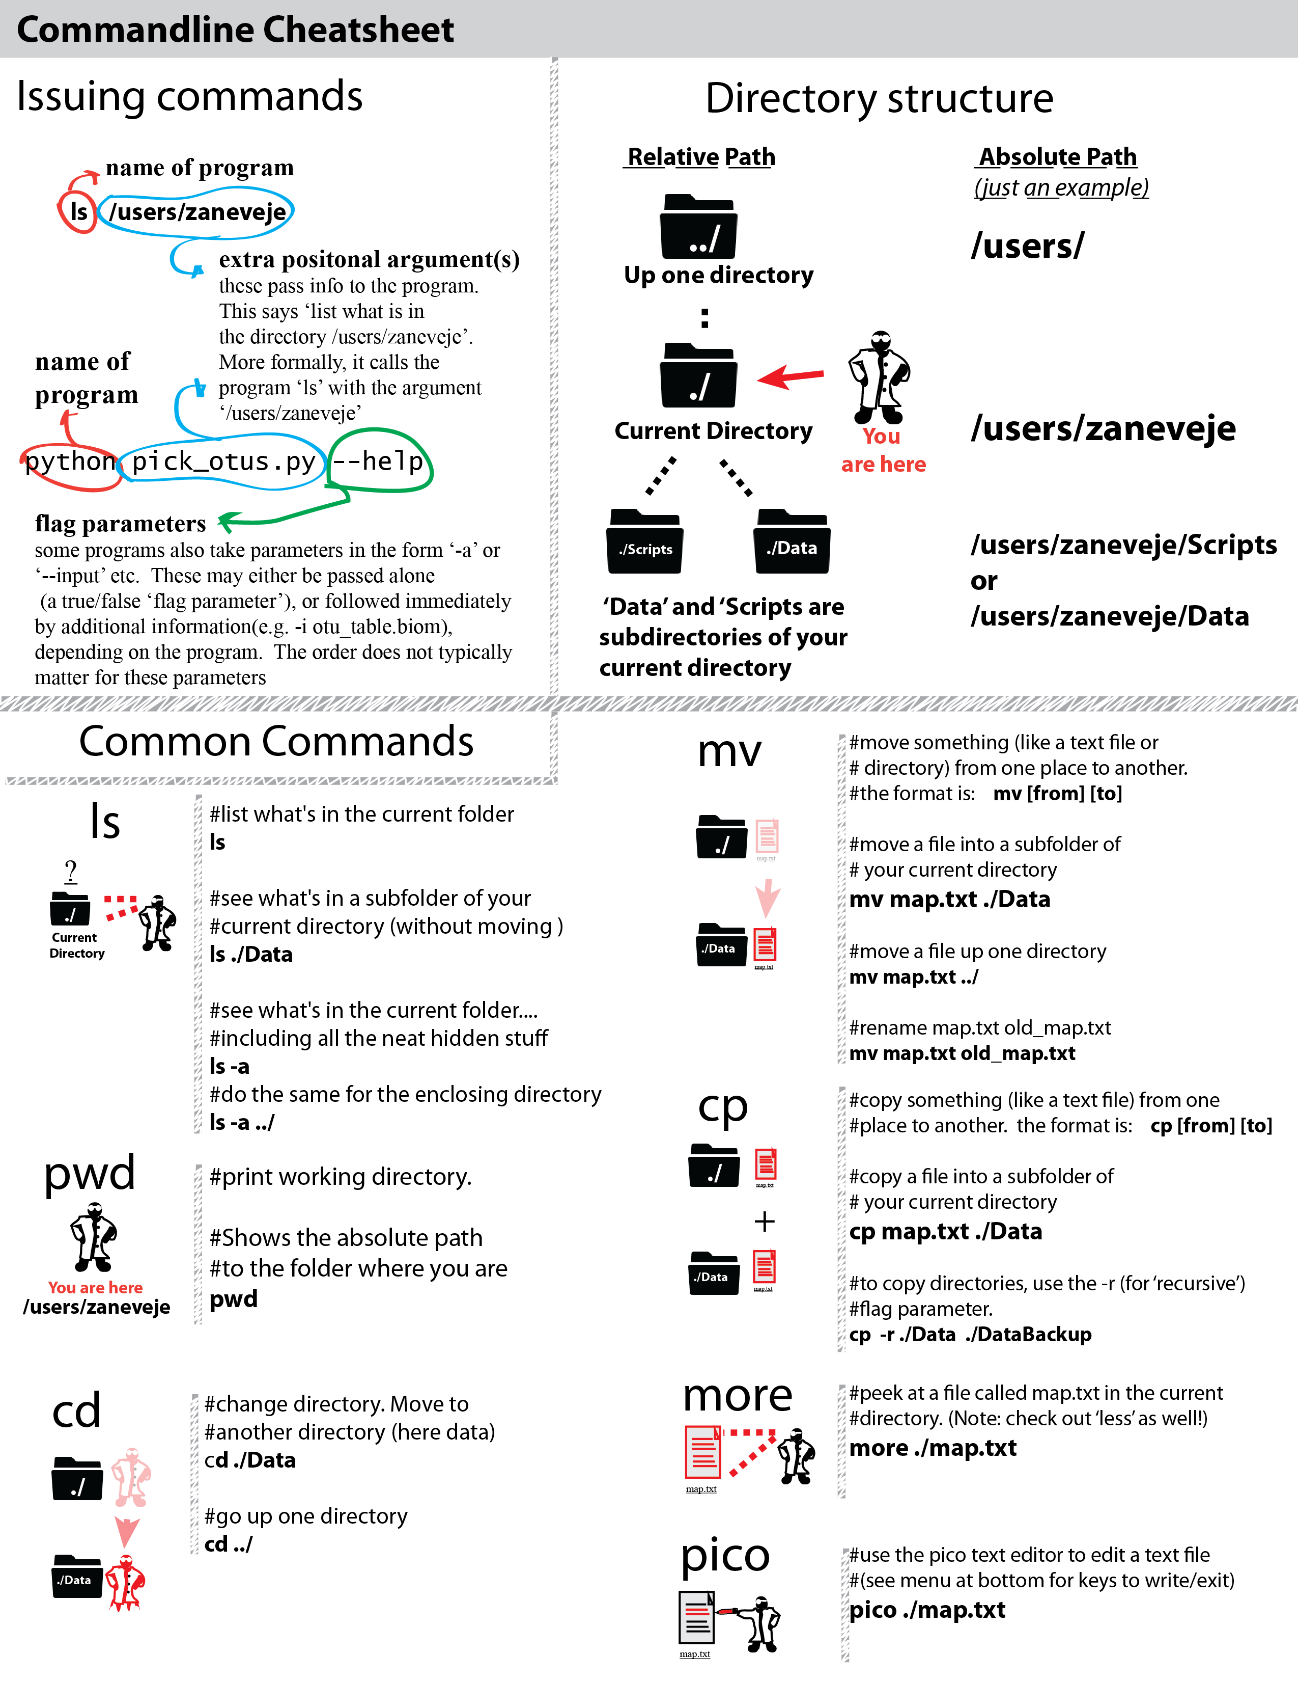

Slide 6
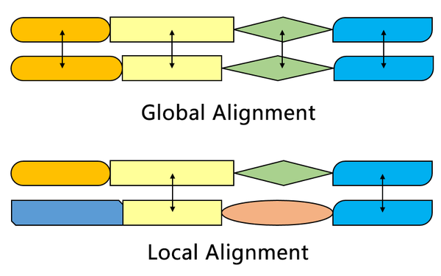
Source: https://en.wikipedia.org/wiki/Smith%E2%80%93Waterman_algorithm

Slide 7
Exercise: Duck vs. Yeast
Structure of Duck
- crystallin
Saccharomyces cerevisiae (a yeast)

Slide 8
Make a BLAST database from yeast translated genes (i.e. predicted protein sequences):
makeblastdb –in orf_trans.fasta -input_type fasta -dbtype prot
(You can find the yeast genome yourself here:
http://downloads.yeastgenome.org/sequence/S288C_reference/orf_protein/)

Slide 9
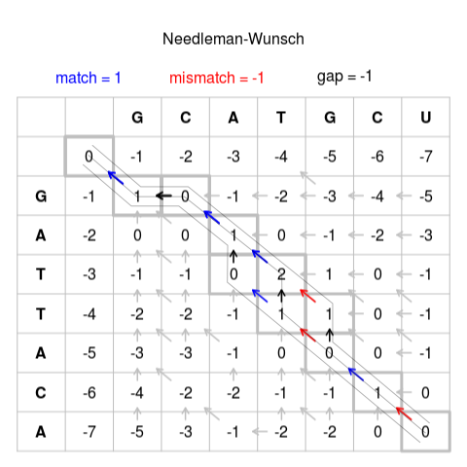
Global Alignment: Needleman-Wunsch
3. Fill in scores
Best score from left, above,
or above-left
+
match/mismatch
score if moving diagonally
OR
Gap penalty if moving up
or down
Source: https://en.wikipedia.org/wiki/Needleman%E2%80%93Wunsch_algorithm

Slide 10
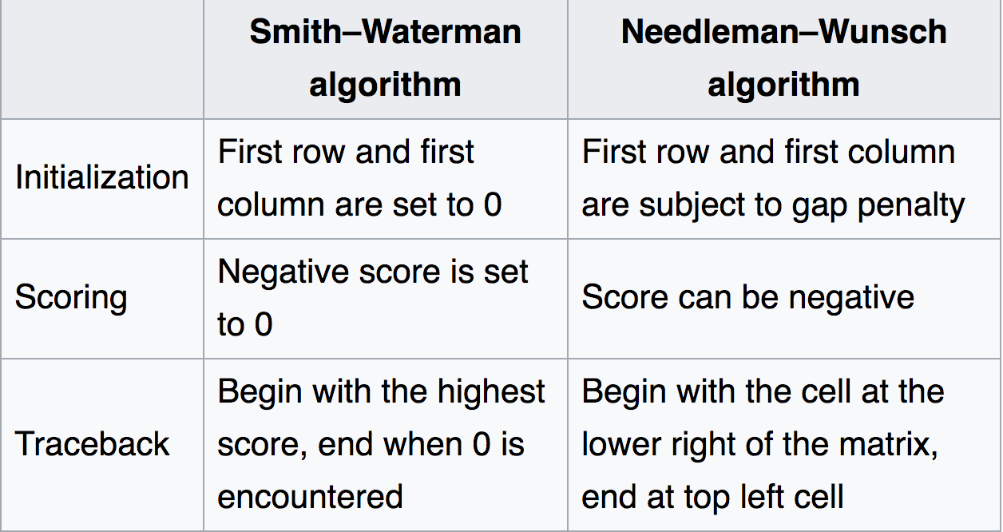
Local Alignment: Smith-Waterman
Like Needleman-Wunsch, but...

Slide 11
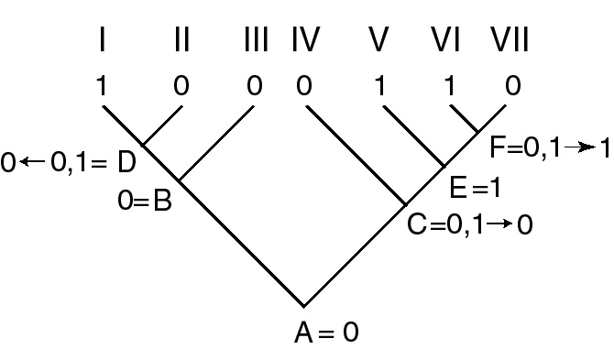
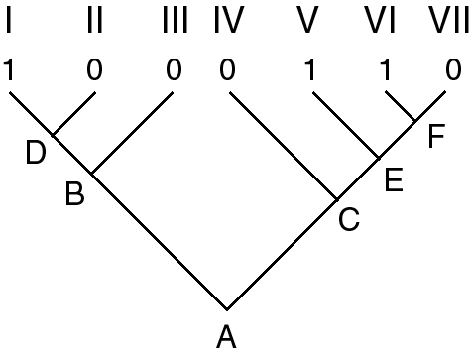
Tree building methods: Parsimony
Parsimony Algorithm: Up-pass
Notice: The number of ambiguous
nodes generated in the down-pass
is the same as the number of evolutionary
transitions needed to explain the tree.
This is used as an optimality criterion for
picking a best tree in parsimony analysis
Gain (0 → 1)
Loss (1 → 0)
Source: http://sites.biology.duke.edu/rausher/lec22_05.html

Slide 12
Parsimony: Long Branch Attraction
A
C
A
C
True
Tree
Branch
colors
reflect
trait
evolution
B
D
B
D
Long branch attraction makes Parsimony statistically inconsistent, in that if LBA is present,
more data does not imply a better tree

Slide 13


Tree building methods: Bayesian (Metropolis-Coupled MCMC or MC³)
Solution: combine both a ‘hot’ and ‘cold’ chain, swap the cold chain with a heated chain
with a chance proportional to how good (high) their solutions are.
“Swap!”
Source:http://www.wikiwand.com/en/Bayesian_inference_in_phylogeny

Slide 14
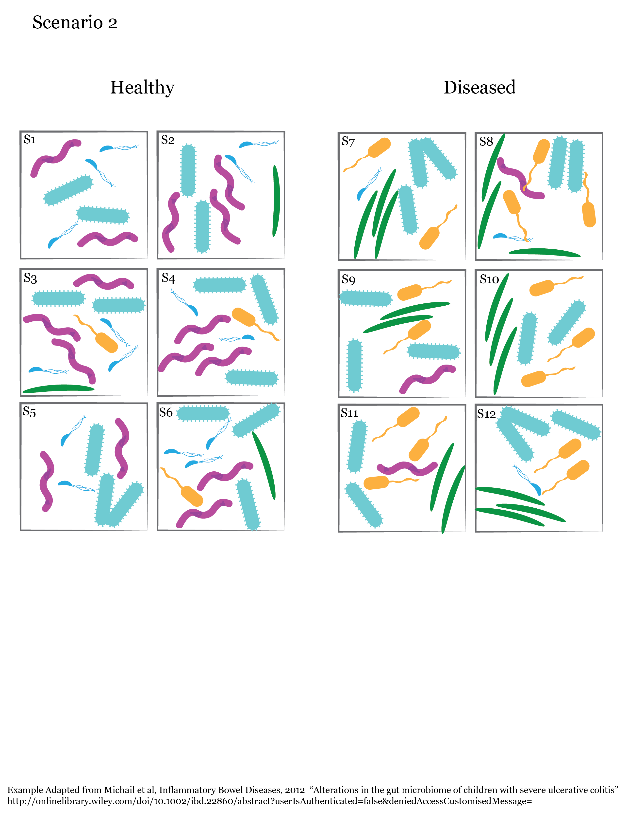

Measuring microbiomes:
β Diversity

Slide 15
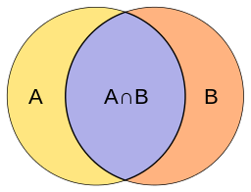
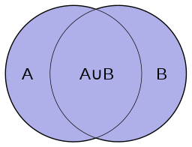
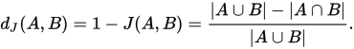
Measuring microbiomes:
β Diversity
How should we measure differences between our communities?
Count how many types are shared vs. unique?

Slide 16

Data visualization: principles
Bioinformatics Week 5 Day 2 Jesse Zaneveld

Slide 17
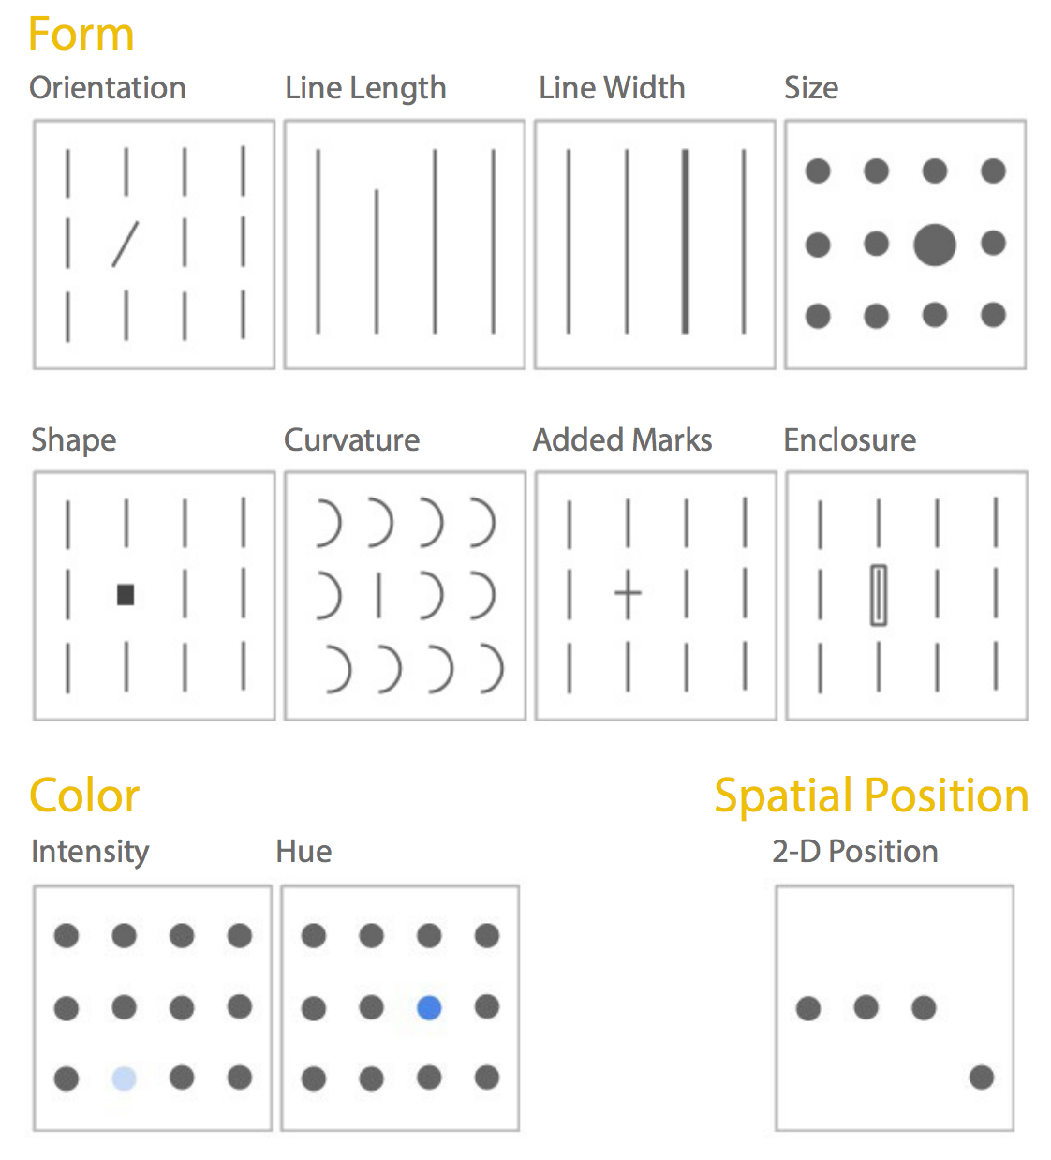
Pre-attentive attributes
...but of these only line
length and spatial
position reliably convey
quantitative information.
Source: http://www.fusioncharts.com/whitepapers/downloads/Principles-of-Data-Visualization.pdf

Slide 18


The Hotel Monte Carlo: permutation tests
Bioinformatics Week 6 Day 2 Jesse Zaneveld

Slide 19
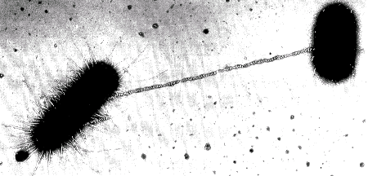
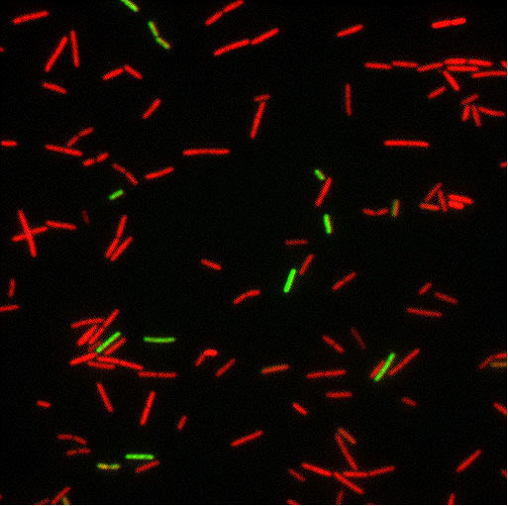
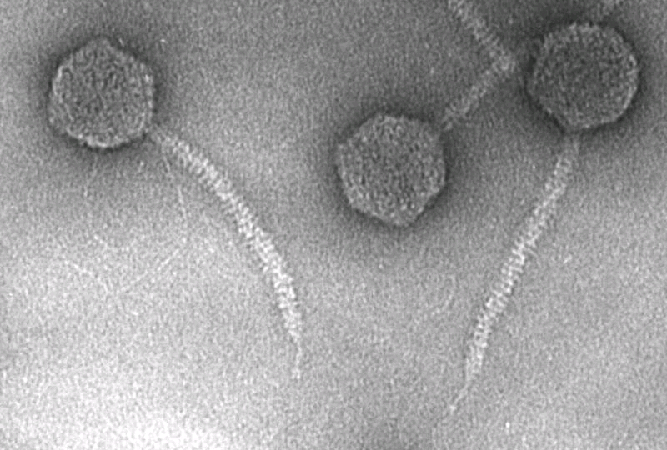
Horizontal Gene Transfer (HGT): gene transfer between lineages
Horizontal
Gene
Transfer
Vertical
Inheritance
Common HGT Mechanisms:
Conjugation
Transformation
Phage Transduction
Notes:
While traditional inheritance is vertical, from parents to offspring, Distant microbial organisms, are capable of transferring genes horizontally as well – almost as if by petting a zebra we could sometimes acquire it’s stripes.
Several mechanisms have been worked out by which such gene transfers can occur, including conjugation (or bacterial sex), transformation (the uptake of raw DNA from the environment) and phage transduction (or the transfer of DNA by viruses that infect bacteria)
Tree (modified from):
Nicolas et al. BMC Evolutionary Biology 2007 7:141 doi:10.1186/1471-2148-7-141
Bacterial Conjugation:
http://tidepool.st.usm.edu/pix/bactconjug.gif
Bacterial bi-stability in transformation (from Dubnau’s website)
www.phri.org/research/images/dubnau_image.jpg
Lamda phage:
www.biochem.wisc.edu/inman/empics/virus.htm

Slide 20
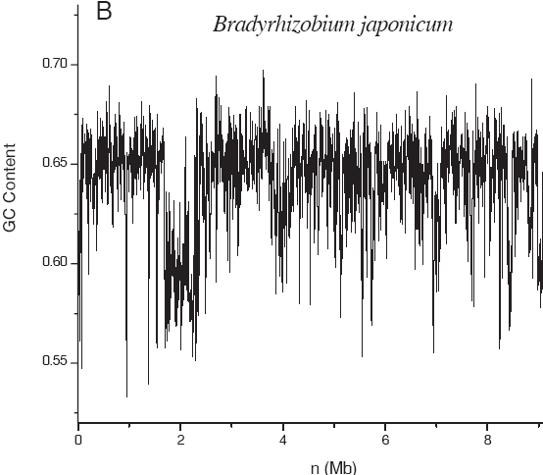
Compositional Methods for HGT Detection
Low GC-content region
may indicate gene transfer from
a low-GC organism
Notes:
A second method for detecting HGT is by examinging the composition of genomes. Different types of bacteria have characteristic patterns of A T C and G residues
…by calculating frequencies we can find atypcial genes that are likely to have come from a different type of bacterium.

Slide 21
2nd Order Uniform Markov Models:
C
Order=K=2 → ‘AT’
K+1 → ‘AT’ + ‘?’
We want to find the probability
of each nucleotide given a preceding
‘AT’…
P(AT) P( C| AT ) = ?
P(AT) P( T | AT ) = ?
P(AT) P(G | AT) = ?
P(AT) P(A | AT) = ?
We can do this by counting
occurances of AT, ATC, ATT, ATG and
ATA in a genome.
T
G
AT
.09
A

Slide 22
3rd Order Approximation to English Words
unassholerry
stered
aristfully
bariatric
nonsel
tanaccous
saddisflies

Slide 23
Types of Networks – Erdős–Rényi model
Null model(Gilbert version): For n nodes and p edges, p edges are selected
From the set of all possible edges with uniform (equal) probability

Slide 24
Types of Networks – Barabási–Albert model
Preferential attachment: Nodes with more edges (higher degree) have greater
Probability of attachment

Slide 25
K-means clustering– unsupervised
Input: you supply a given number of clusters k (note this choice must be
externally justified or taken as arbitrary)
Output: the algorithm minimizes the sum-of-squared distances between each
point and the nearest cluster centroid
Steps (subset of general expectation-maximization):
Draw random means
Associate each point with the nearest mean
Calculate the centroid of each cluster.
Treat the centroids as the new means and return to step 2.

Slide 26
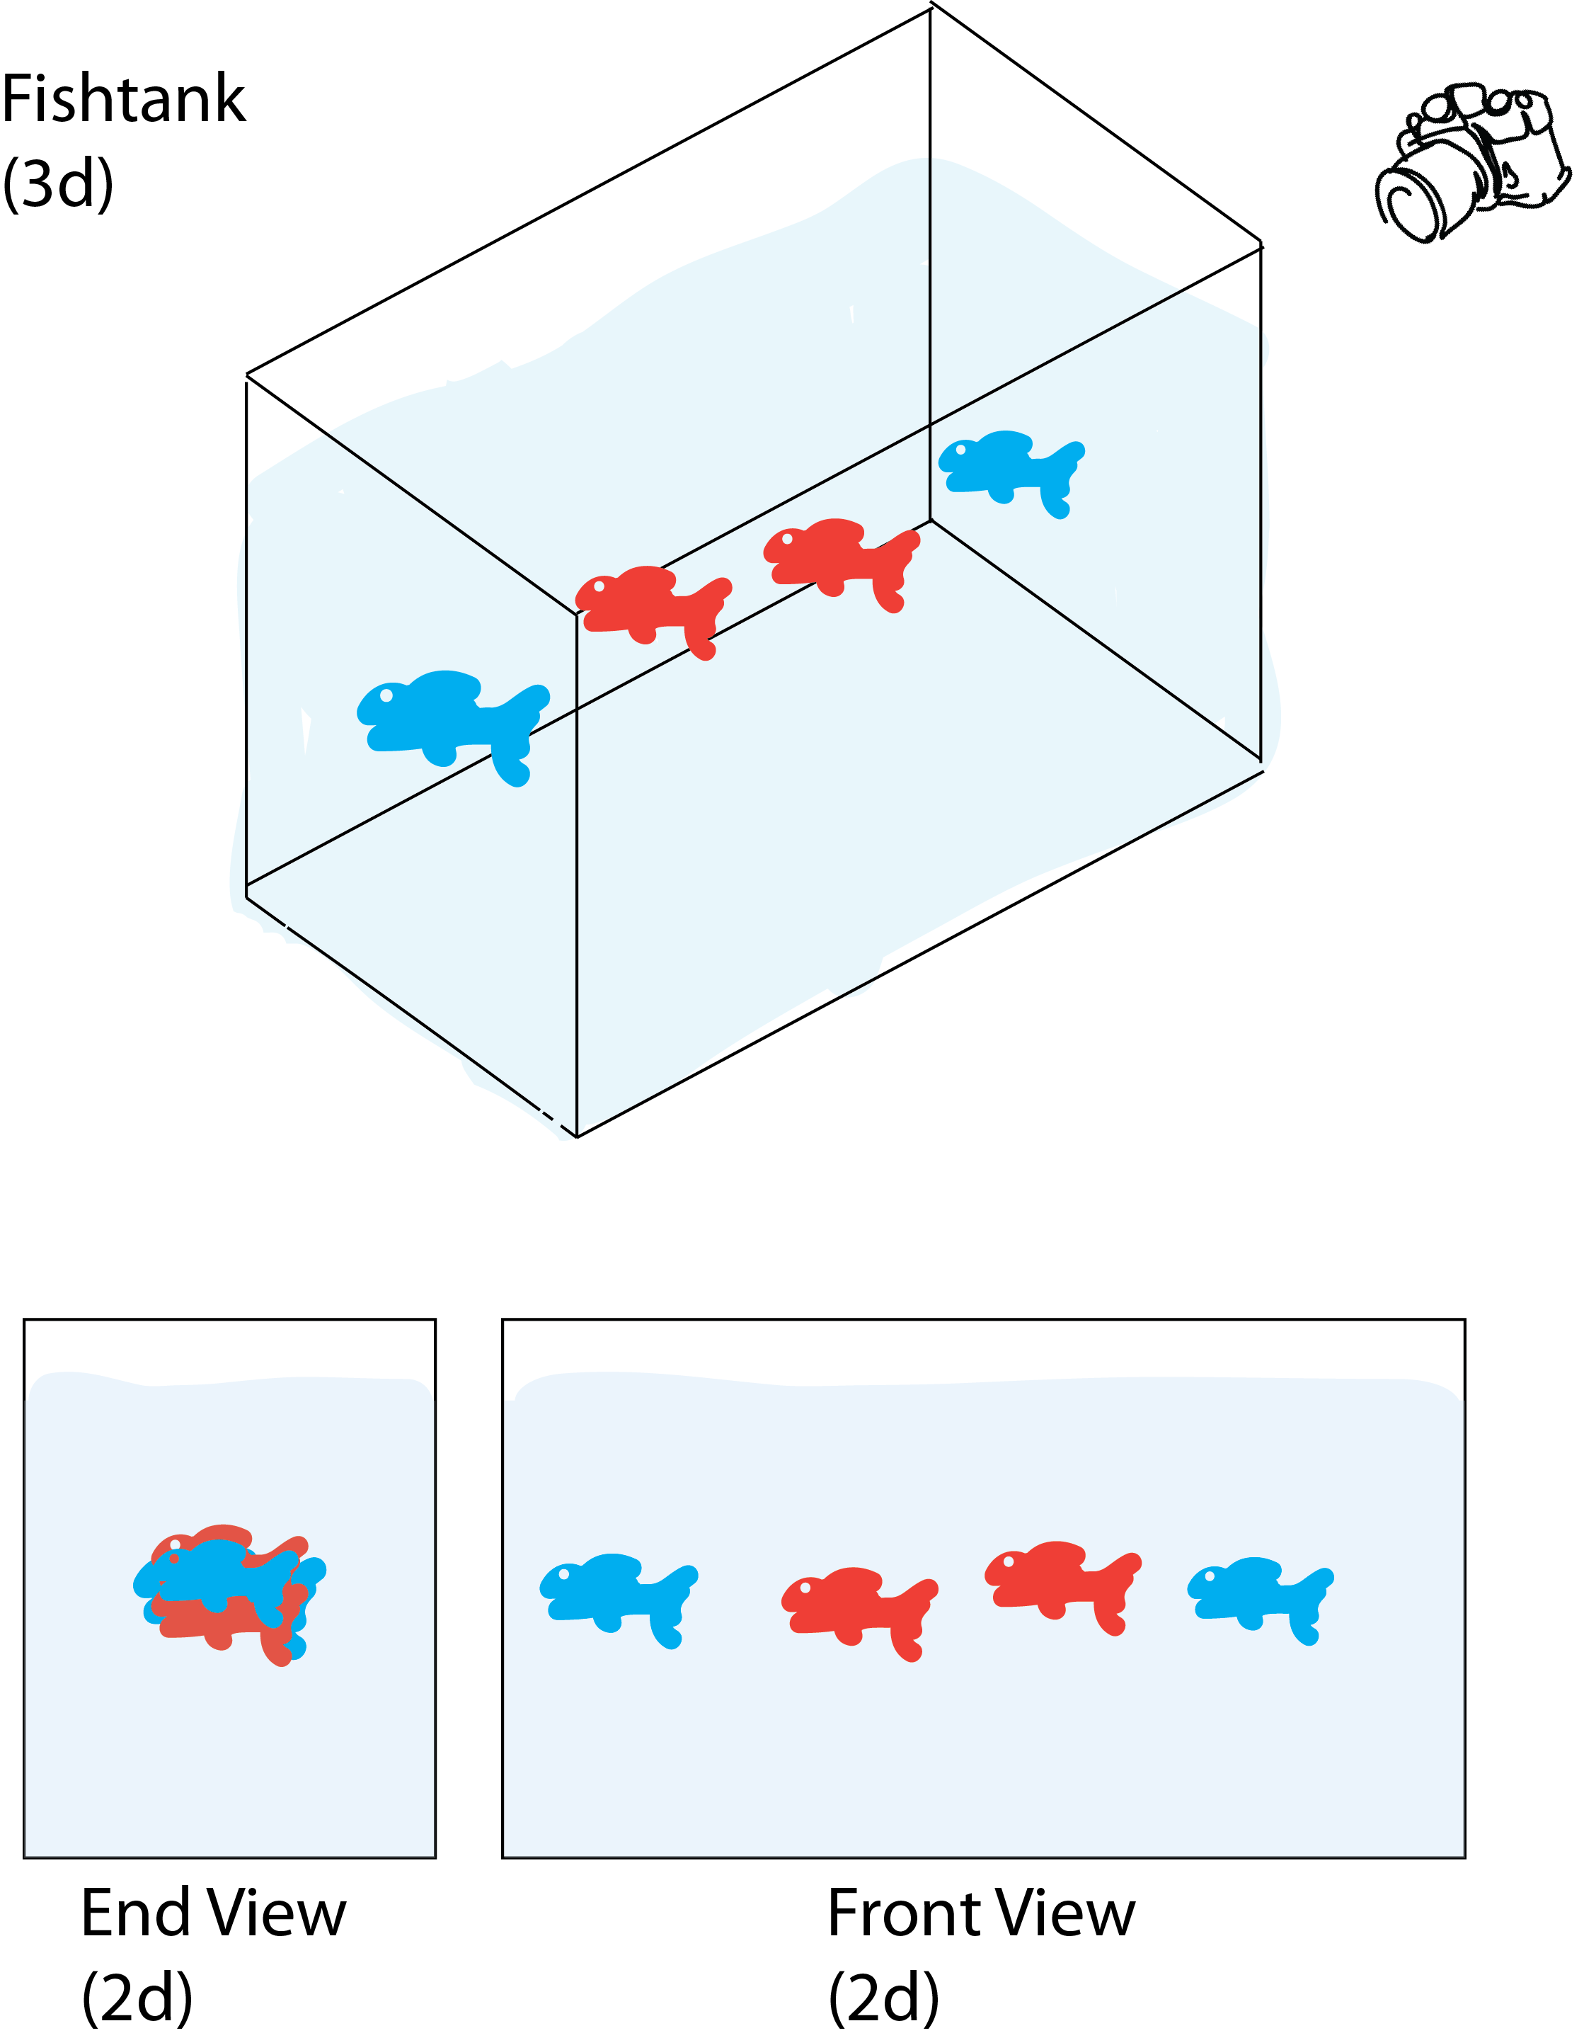
Measuring microbiomes:
Principal Coordinates Analysis (PCoA)
Beta-diversity distance matrix
S2 S4 S7
S2
S4
S7
0.0
0.13
0.0
0.66
0.60
0.0

Slide 27
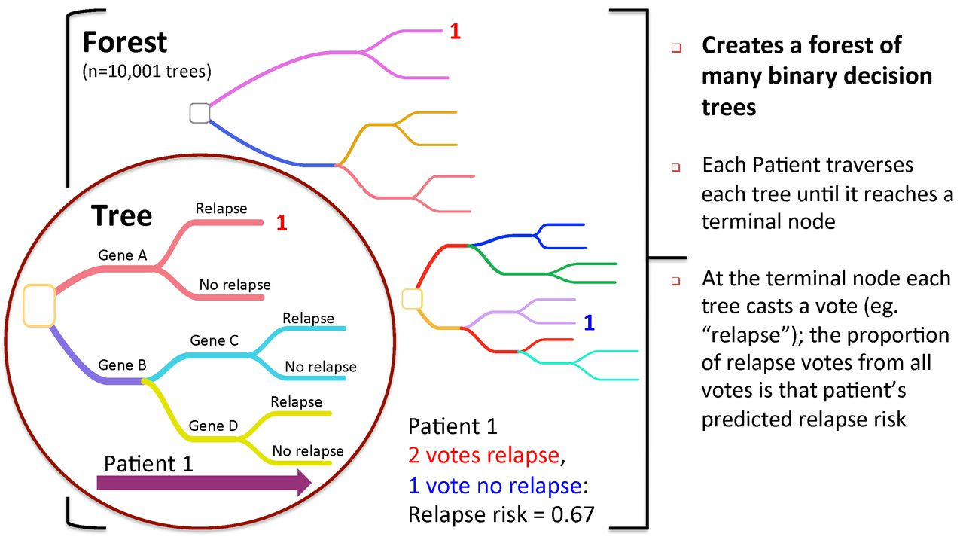
Random Forest Analysis – Supervised Classifier

Slide 28
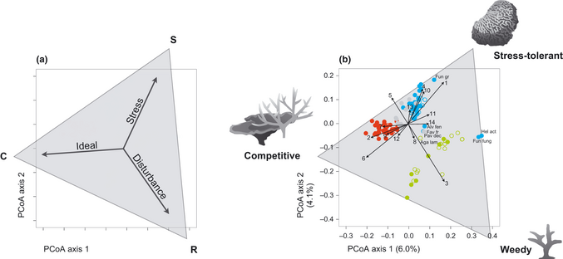
Combining Methods
Ordination:
Identify simple axes that
separate samples/species
Clustering:
Identify clusters of samples
in data (e.g. k-means clustering)
or
Test a hypothesis about sample
categories
Machine Learning (aka
Random Forests)
Identify unique features that
identify each cluster
Source: Darling et al., Ecology Letters, 2012

Slide 29
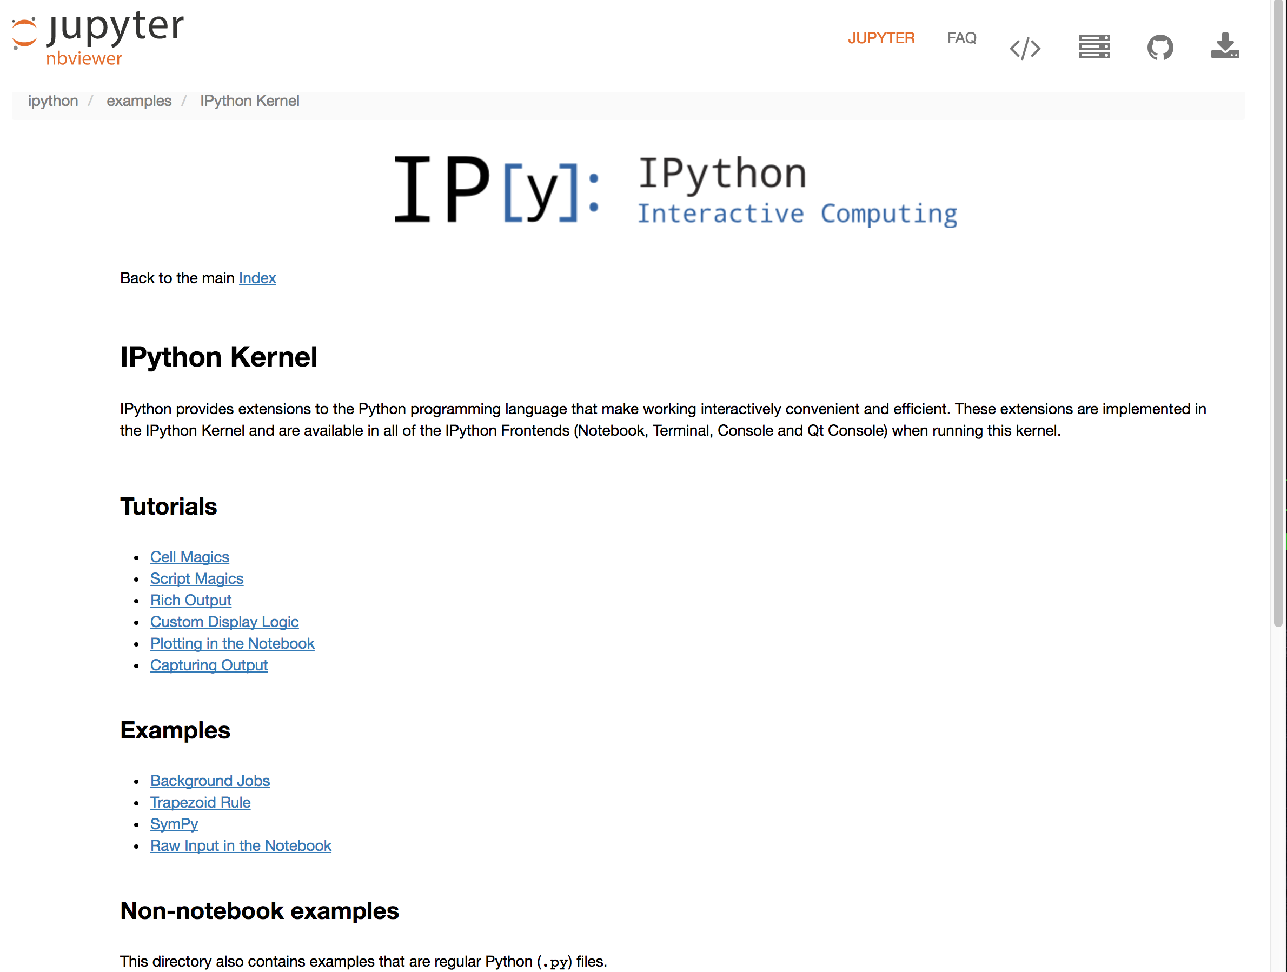
Reproducibility
Computational Biology Week 7 Day 2 Jesse Zaneveld
Source: Koren et al., PLoS Computational Biol, 2013

Slide 30
…and your projects covered so much more:
Machine Learning of SNPs for Eye Color
Antigenicity Predictions
Machine Learning for Heart Disease Severity
Searching for convergent evolution in echolocation genes
Evolution of genes involved potentially in sociability
New tools for characterizing codon usage & detecting
gene transfer
Distribution of Antibiotic Resistance Genes
Phylogenetics of Kokanee Salmon Conservation
Searching for Reservoirs an Emerging Deadly Fungal Pathogen in Historical Datasets
Source: Koren et al., PLoS Computational Biol, 2013

Slide 31
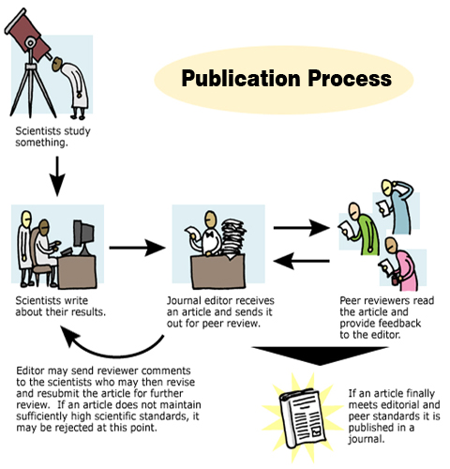
Polishing and Publishing
Jesse Zaneveld

Slide 32
Polishing and Publishing
Jesse Zaneveld

Slide 33
Polishing and Publishing
Jesse Zaneveld

Slide 34
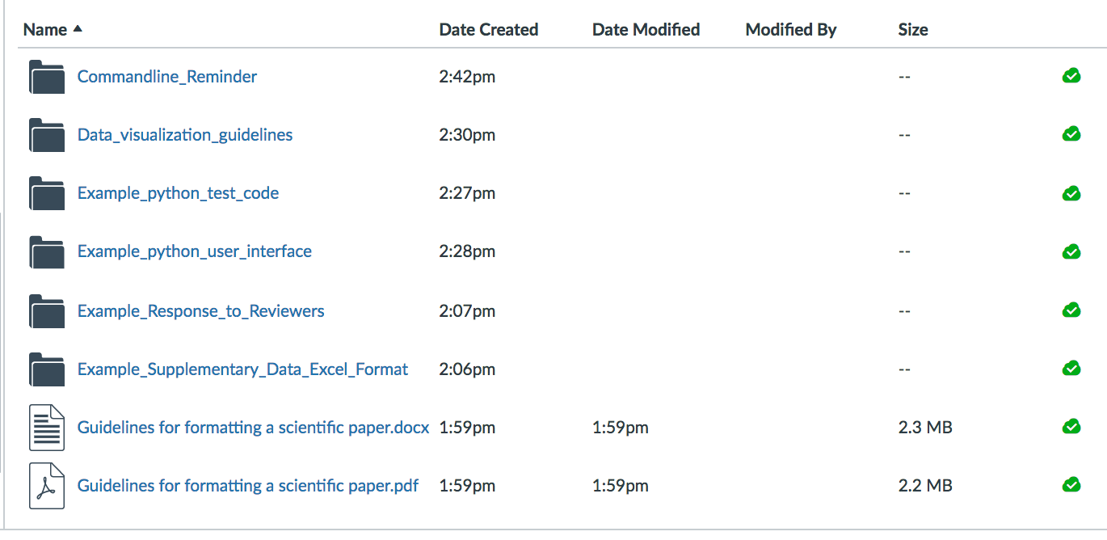
Polishing and Publishing
Publishing Toolkit. I’ve put together reference materials for putting
Together a first paper in the Canvas folder for today’s lecture.
I recommend downloading and saving for future reference, since the examples
in the packet will let you modify from a working example rather than having to
start from scratch.

Slide 35
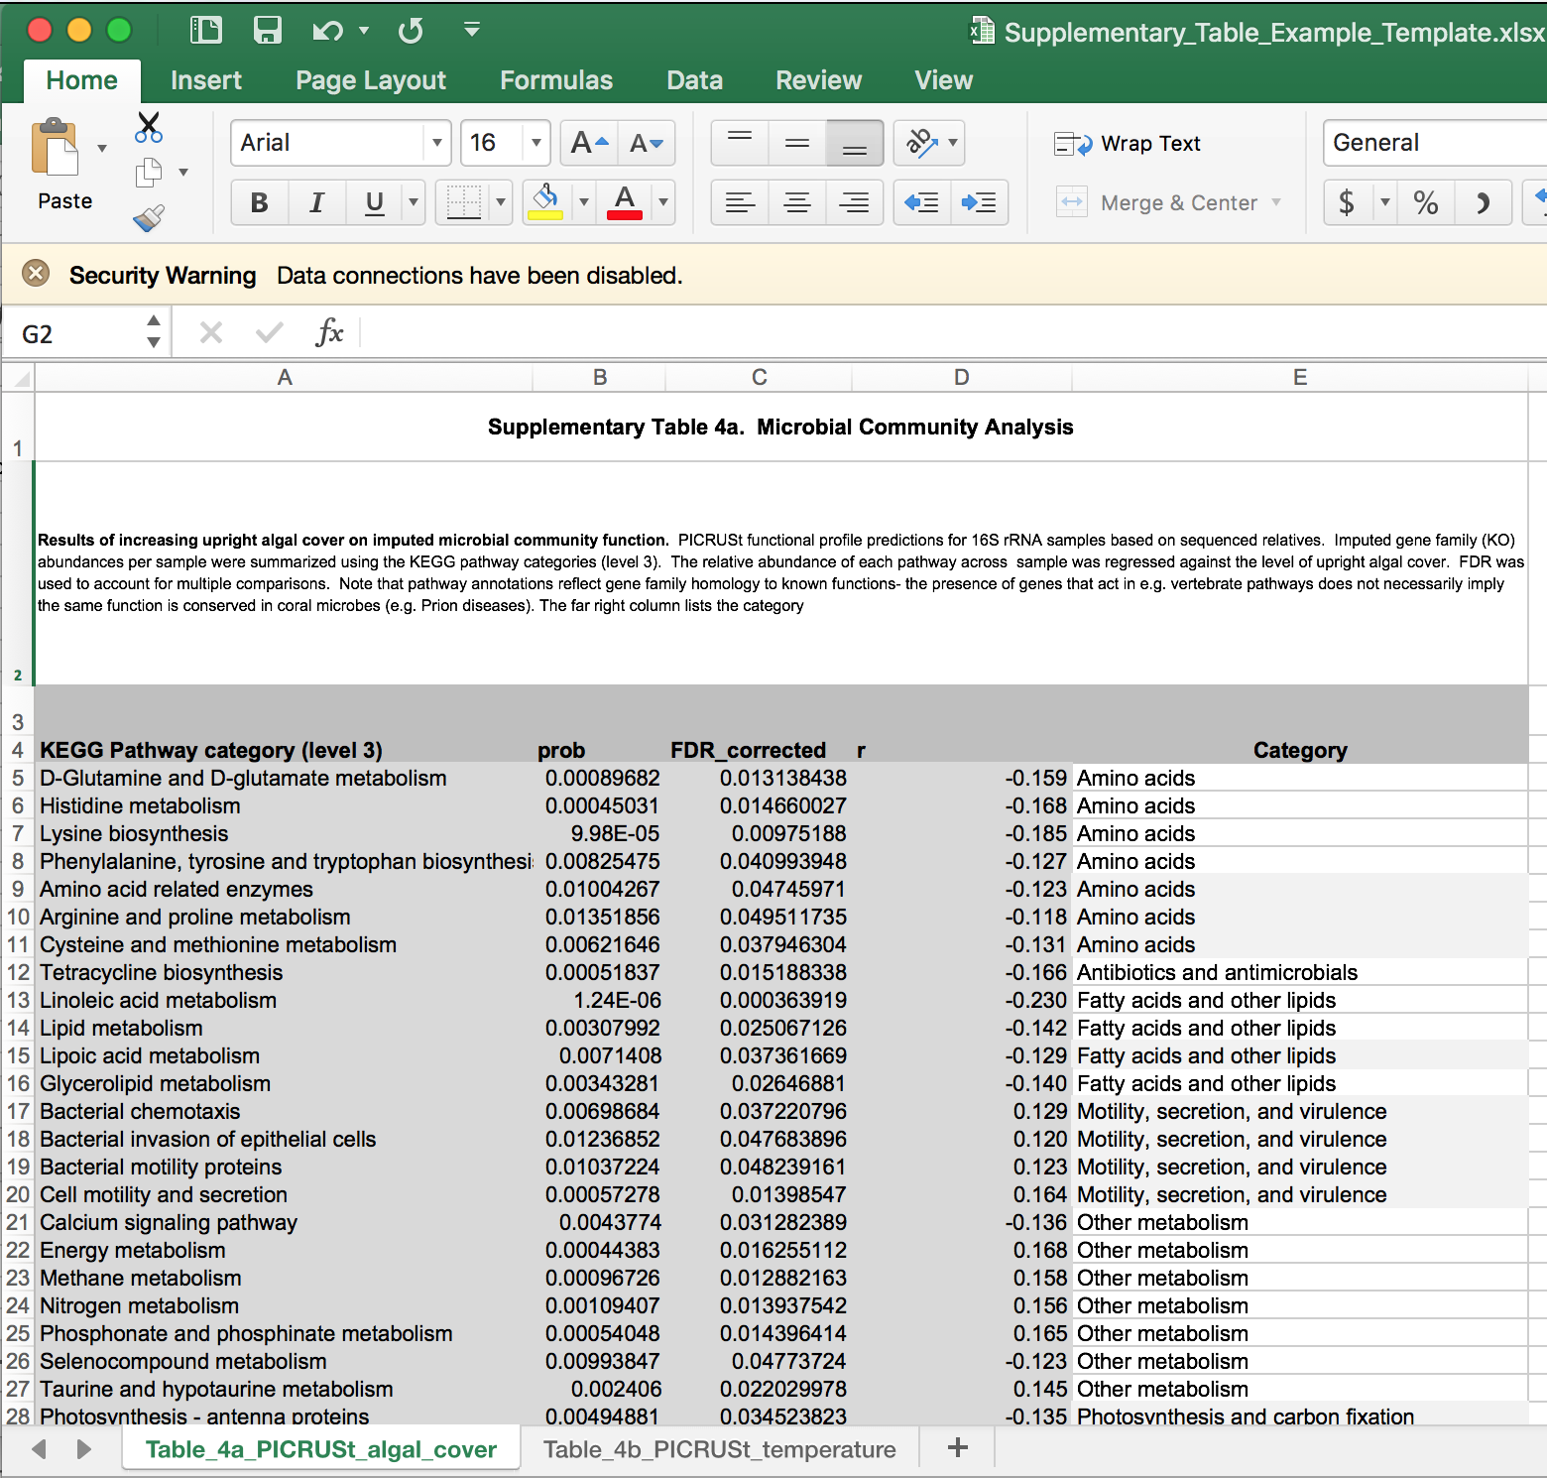
EXAMPLE SUPPLEMENTARY DATA FILE
SUMMARY and
EXPLANATION
Keep data in
a format that can be
easily converted to
Machine-readable
With one copy/paste
(beyond that its OK
to mark up for human-
readability with
shading, etc)

Slide 36
Writer

Slide 37
Reader
Writer

Slide 38
Polishing and Publishing
Jesse Zaneveld

Slide 39
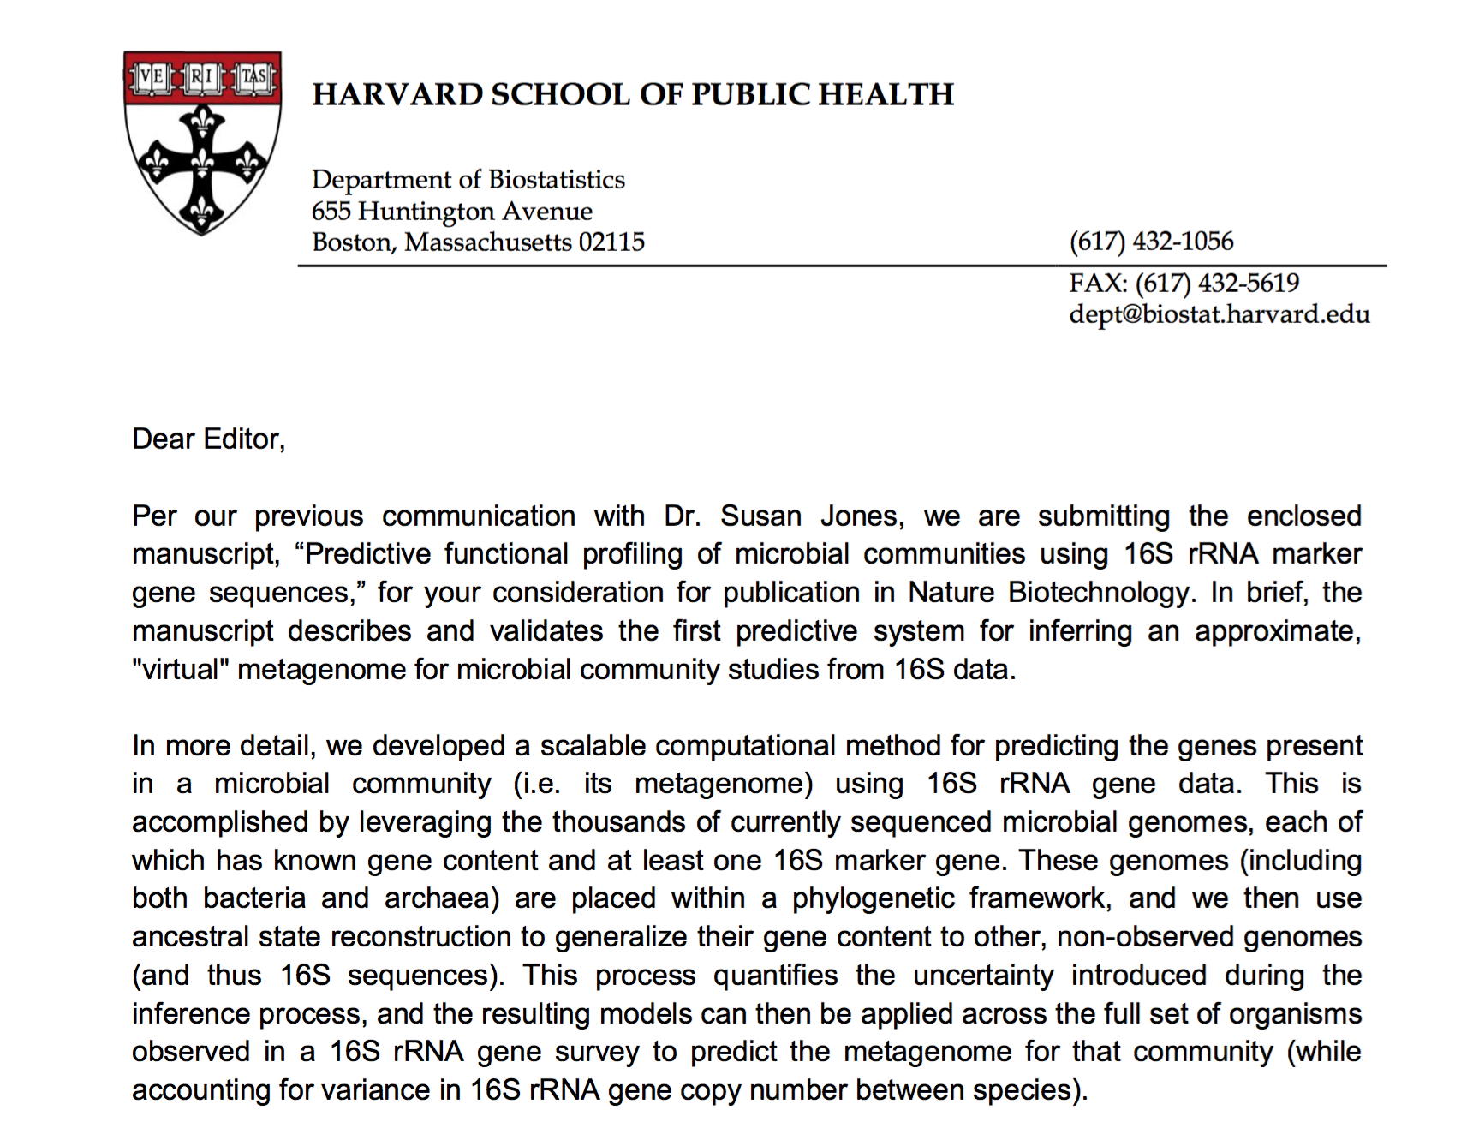
EXAMPLE COVER LETTER
Source: http://www.ijasrjournal.org/wp-content/uploads/2014/04/111.jpg

Slide 40
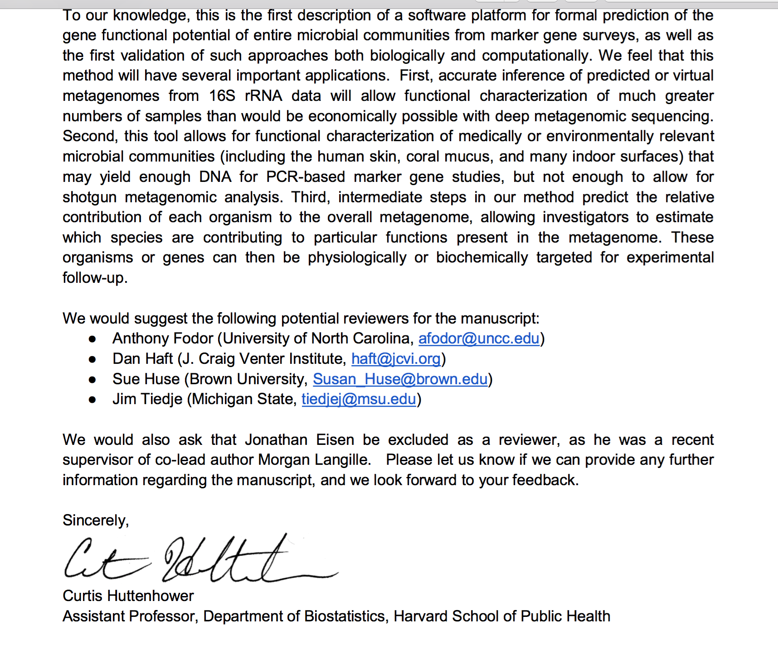
EXAMPLE COVER LETTER
Source: http://www.ijasrjournal.org/wp-content/uploads/2014/04/111.jpg

Slide 41
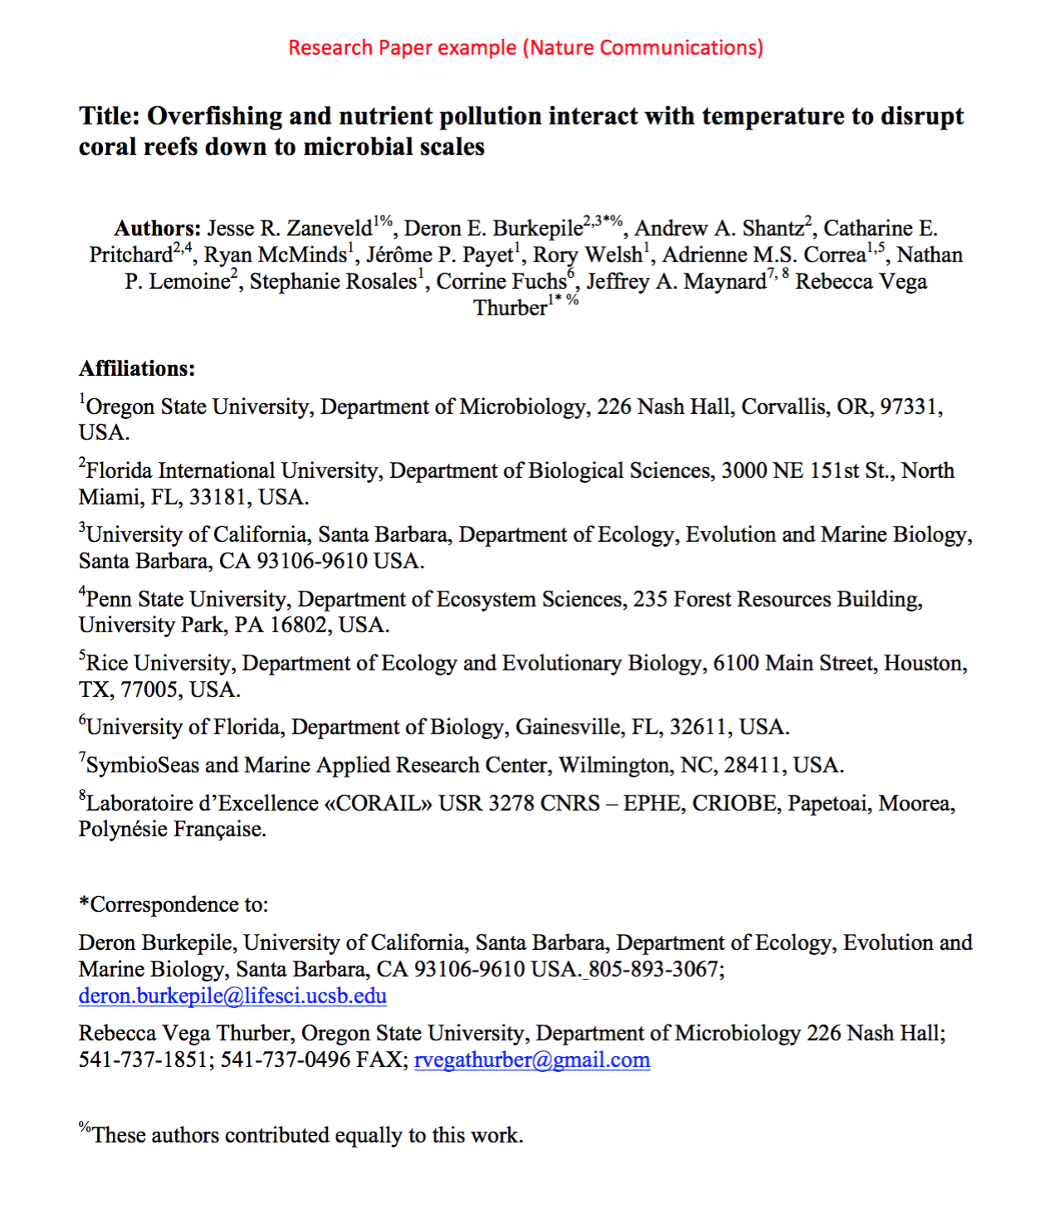
EXAMPLE TITLE PAGE

Slide 42
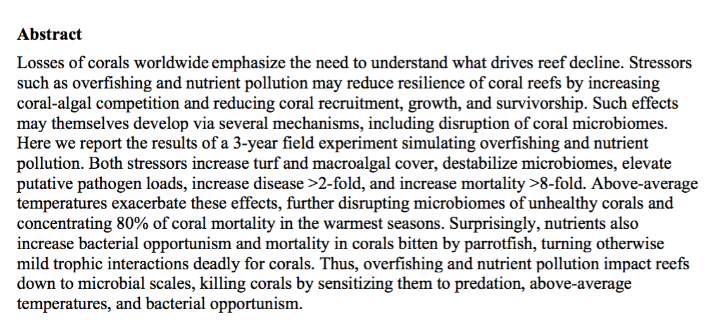
EXAMPLE TITLE PAGE

Slide 43
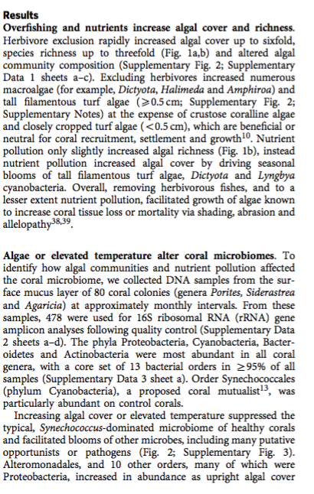
EXAMPLE TITLE PAGE
SUBHEADINGS!

Slide 44
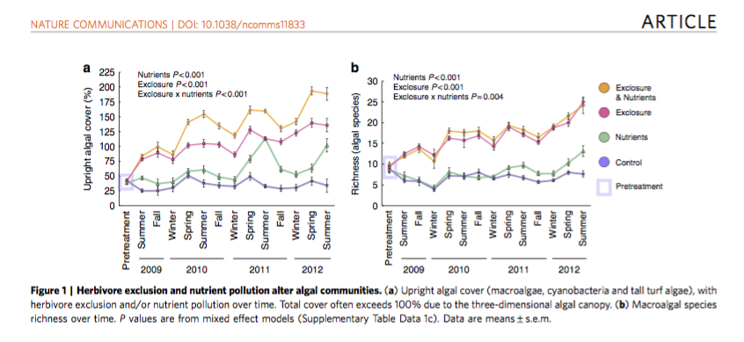
EXAMPLE
SUBHEADINGS!

Slide 45
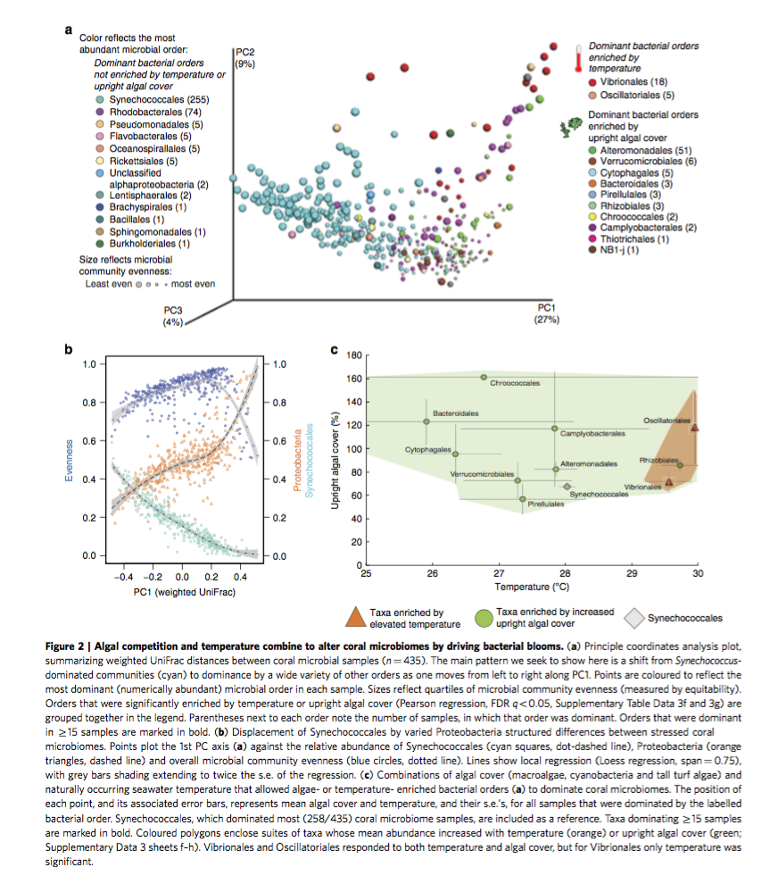
EXAMPLE
SUBHEADINGS!

Slide 46
EXAMPLE ABSTRACT
Frame General problem: 13 words/ 1 sentence
Losses of corals worldwide emphasize the need to understand what drives reef decline.
Necessary background to understand our research question: 37 words/ 2 sentences
Stressors such as overfishing and nutrient pollution may reduce resilience of coral reefs by increasing coral-algal competition and reducing coral recruitment, growth, and survivorship. Such effects may themselves develop via several mechanisms, including disruption of coral microbiomes.
“Here we report” sentence of what you’ll hear about if you read our paper: 1 sentence 15 words
Here we report the results of a 3-year field experiment simulating overfishing and nutrient pollution
Results: 62 words/ 3 sentences / 3 specific “quote at a cocktail party” numbers
Both stressors increase turf and macroalgal cover, destabilize microbiomes, elevate putative pathogen loads, increase disease >2-fold, and increase mortality >8-fold. Above-average temperatures exacerbate these effects, further disrupting microbiomes of unhealthy corals and concentrating 80% of coral mortality in the warmest seasons. Surprisingly, nutrients also increase bacterial opportunism and mortality in corals bitten by parrotfish, turning otherwise mild trophic interactions deadly for corals.
Conclusion 1 sentence / 24 words
Thus, overfishing and nutrient pollution impact reefs down to microbial scales, killing corals by sensitizing them to predation, above-average temperatures, and bacterial opportunism.

Slide 47
Polishing and Publishing – Thinking Long Term
Original Paper
Source: http://www.ijasrjournal.org/wp-content/uploads/2014/04/111.jpg
Notes:
In the context of ONE publication/product/figure writing
clean modular code with test code, conducting reproducible
research takes more time.

Slide 48
Polishing and Publishing – Thinking Long Term
Repeat interactions:
Communities are small, so being
generous (within reason) and open
in your research is usually net-
beneficial for both you
and the field long-term.
Original Paper
Source: http://www.ijasrjournal.org/wp-content/uploads/2014/04/111.jpg
Notes:
In the context of ONE publication/product/figure writing
clean modular code with test code, conducting reproducible
research takes more time.

Slide 49
Polishing and Publishing – Thinking Long Term
Papers describing an
open-access tool
implementing
the method
Modular
code &
Test code
Original Paper
Source: http://www.ijasrjournal.org/wp-content/uploads/2014/04/111.jpg
Notes:
In the context of ONE publication/product/figure writing
clean modular code with test code, conducting reproducible
research takes more time.

Slide 50
Polishing and Publishing – Thinking Long Term
Papers
describing
new versions
of the tool
Papers describing an
open-access tool
implementing
the method
Modular
code &
Test code
Original Paper
Source: http://www.ijasrjournal.org/wp-content/uploads/2014/04/111.jpg
Notes:
In the context of ONE publication/product/figure writing
clean modular code with test code, conducting reproducible
research takes more time.

Slide 51
Polishing and Publishing – Thinking Long Term
Papers
describing
new versions
of the tool
Papers describing an
open-access tool
implementing
the method
Papers applying
method to new
problems
Modular
code &
Test code
Reproducible/
automated
analysis
Original Paper
Source: http://www.ijasrjournal.org/wp-content/uploads/2014/04/111.jpg
Notes:
In the context of ONE publication/product/figure writing
clean modular code with test code, conducting reproducible
research takes more time.

Slide 52
Polishing and Publishing – Thinking Long Term
Papers
describing
new versions
of the tool
Papers describing an
open-access tool
implementing
the method
Papers applying
method to new
problems
Modular
code &
Test code
Reproducible/
automated
analysis
Consistent &
Comparable metadata
and methods
Original Paper
Metaanalysis
Source: http://www.ijasrjournal.org/wp-content/uploads/2014/04/111.jpg
Notes:
In the context of ONE publication/product/figure writing
clean modular code with test code, conducting reproducible
research takes more time.

Slide 53
Polishing and Publishing
Reproducibility: Close the loop between the raw data you post and your ultimate scientific conclusions. This is a major trend in the field. Added advantage:
if you’ve written your code modularly, this means you can take similar data and
run a complex analysis on it quickly. This is a very easy way to turn 1 first
-authored publication into several additional co-authored publications (applying your
methods to collaborators datasets)
Source: Koren et al., PLoS Computational Biol, 2013

